Slide 1
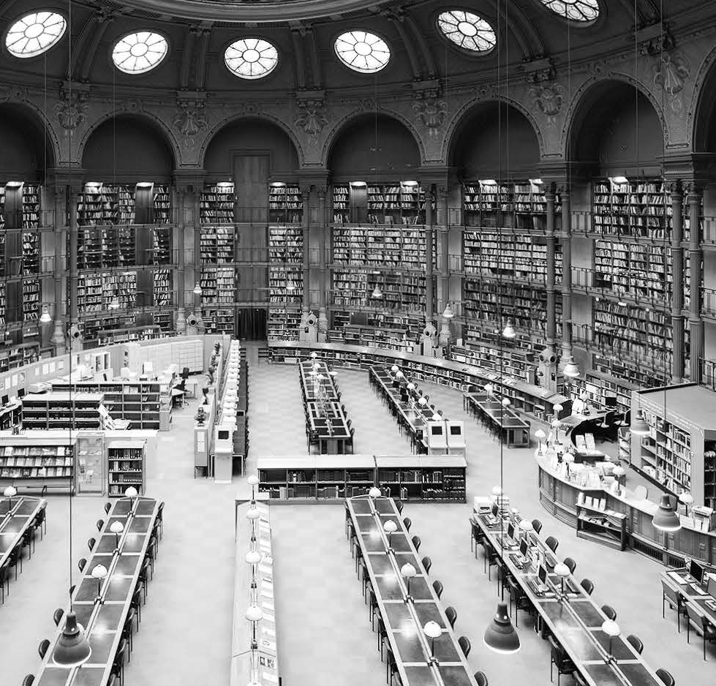
Unit 1
Environment

Slide 2

Unit 1 Environment
Unit Arrangement
1. 学术阅读（4课时）
Text A : Global Warming: A Second Inconvenient Truth----- Selected from the journal Finance &Development (September 2014)
Lead-in, text, New words and expressions 课外完成
Critical reading and thinking (overview, points for discusssion) 课堂完成
Language building-up (specialized vocabulary; academic vocabulary, collocations) 课后完成
2. 学术听、说、写的技能训练（2课时）

Slide 3
Unit 1 Environment
Unit Objectives
1. Professional Knowledge
Get acquainted with some important expressions
2. Reading
Summarize the main ideas of a text and identify essential supporting points
Understand difficult sentences (e.g., sentences with abstract meaning or ambiguous reference)
Analyze complex or controversial issues critically

Slide 4
Unit 1 Environment
Unit Objectives
3. Academic language and discourse
Know what is specialized vocabulary and acquire some specialized vocabulary
Comprehend stylistic differences between formal and informal English and acquire some formal expressions
4. Listening
Make predictions about the content of a lecture

Slide 5
Unit 1 Environment
Unit Objectives
5. Writing
Understand what kind of topic is suitable and manageable for a term paper
Searching for information
6. Researching
Independently locate and study a variety of resources (articles, books, videos, etc.) to conduct a survey of environmental protection

Slide 6

Contents
Reading
Viewing
Speaking
Writing
Notes:
考虑到Writing作为教材中的一个独立板块，且附有相关练习和答案，因此将Writing部分补了回来，并把答案和练习补充在了最后，还请吴老师确认是否可以。
编者：可以。之后单元也会补充该板块。
编辑回复：好的，谢谢吴老师！

Slide 7
Reading
Text A
Text B
Notes:
考虑到Writing作为教材中的一个独立板块，且附有相关练习和答案，因此将Writing部分补了回来，并把答案和练习补充在了最后，还请吴老师确认是否可以。
编者：可以。之后单元也会补充该板块。
编辑回复：好的，谢谢吴老师！

Slide 8
Reading
Text A
Global Warming:
A Second Inconvenient Truth
Lead-in task
While reading
After reading tasks

Slide 9
Lead-in Task
Do you agree that human activities have negative impacts on global warming? Why or Why not?
https://www.bilibili.com/video/BV1CU4y157RG?from=search&seid=15506743628165763727&spm_id_from=333.337.0.0

Slide 10
Text A Lead-in
task
Critical thinking
Do you agree that human activities have negative impacts on global warming? Why or Why not?
Reference answers
The burning of coal, oil and gas
The burning of coal, oil and gas release gases like carbon dioxide and nitrous oxide into the atmosphere, which exacerbates the “greenhouse effect”—warming that results when the atmosphere traps heat radiating from Earth toward space.

Slide 11
Text A Lead-in
task
Critical thinking
Reference answers
Deforestation
Trees affect the climate by absorbing carbon dioxide during photosynthesis. When trees are cut down, they release the carbon they are storing into the atmosphere, where it mingles with greenhouse gases from other sources and contributes to global warming accordingly.

Slide 12
Text A Lead-in
task
Critical thinking
Reference answers
Agriculture & Farming
Fertilizers containing nitrogen produce nitrous oxide emissions. Livestock like sheep and cattle produce large amounts of methane. Both are greenhouse gases.
Industrial pollution
Industrial production creates chemical gases containing synthetic compounds that contribute to the destruction of the ozone layer.

Slide 13
Text A While reading
The focused issue
global warming
Reading task
What is the second inconvenient truth?

Slide 14
Text A While reading
Supplementary Information
1. George A. Akerlof
George A. Akerlof is a 2001 recipient of the Nobel Prize in Economic Sciences. He is Koshland Professor of Economics Emeritus at the University of California, Berkeley. He was honored for his theory of asymmetric information in Economics and its effect on economic behavior.

Slide 15
Text A While reading
Supplementary Information
2. global warming
Global warming is the phenomenon of increasing average air temperatures near the surface of Earth since the pre-industrial period (between 1850 and 1900) due to human activities, primarily fossil fuel burning. It increases heat-trapping greenhouse gas levels in Earth’s atmosphere. The term is frequently used interchangeably with “climate change”, though the latter refers to both human-induced and naturally produced warming and the impacts they have on our planet.

Slide 16
Text A While reading
Supplementary Information
3. the Earth’s atmosphere
The atmosphere of Earth is the layer of gases retained by Earth’s gravity, surrounding the planet Earth and forming its planetary atmosphere. It has five major and several secondary layers. From lowest to highest, the major layers are the troposphere, stratosphere, mesosphere, thermosphere and exosphere. It protects life on Earth by creating pressure allowing for liquid water to exist on the Earth’s surface, absorbing ultraviolet solar radiation, warming the surface through heat retention, and reducing temperature extremes between day and night.

Slide 17
Text A While reading
Supplementary Information
4. anthropogenic climate change
There is evidence that modification of the environment by humans may result in future climate change. Anthropogenic climate change is defined by the human impact on Earth’s climate. Human-induced climate change is directly linked to the amount of fossil fuels burned, aerosol releases and land alteration from agriculture and deforestation. Climate change caused by humans may occur at a faster rate than that previously caused by nature and may involve both changes in average temperature conditions and the frequency of occurrence of extreme events.

Slide 18
Text A While reading
Language Support
Solemn pronouncements are made, but the can of global warming action is once again kicked down the road. (Para. 2)
The idiom “kick the can down the road” means “putting off work on an issue for a later date”（拖着不解决问题；缓兵之计）.
e.g. I don’t think we should kick the can down the road and let
our grandkids solve that problem.
The citizens know what’s going on, and I think they know
that the Congress will continue to kick this can down the
road and that they’ve got to act.

Slide 19
Text A While reading
Language Support
The Earth’s atmosphere acts like a protective blanket around us. (Para. 3)
Collectively we humans have a baby: the Earth. (Para. 4)
Any parent would rush to rescue a baby in such circumstances. (Para. 5)
Different kinds of rhetorical devices have been used in the text. For example:
In the first sentence above, simile is used in the phrase introduced by “like”. Here, “blanket” refers to “The Earth’s atmosphere”.
In the second sentence, personification is used to endow the Earth with human qualities, which is described as a “baby”.
In the third sentence, metaphor is used to make an implicit comparison. Here, “parent” represents “mankind”.

Slide 20
Text A While reading
Language Support
We defer to the conclusions of “scientists.” (Para. 5)
defer to: agree to accept sb.’s opinion or decision because you have respect for that person 听从；遵从
e.g. He deferred to his parents' wishes.
Preventing and controlling the loan risk must defer to the government policy about cereals dealing and
macroscopic market controlling.

Slide 21
Text A While reading
Language Support
The scientists have spoken, with all but unanimous voice and often with great passion and force, but the professional dispassion of science muffles the message. (Para. 5)
The phrase “all but” refers to “very nearly, almost” （几乎；差一点）. In the text, “with all but unanimous voice” can be paraphrased as “in almost complete agreement”.
e.g. The little boy is all but drowned.
Herbalism had become an all but extinct skill in the Western world.

Slide 22
Text A While reading
Language Support
Optimal policy also calls for subsidization of research and development into ways to reduce emissions. (Para. 7)
call for: to need or deserve a particular type of behavior or treatment 需要（某种行为或对待方式）
This is the meaning of “call for” in the text. Other meanings of “call for” are provided as below:
i) if a group of people call for something, they ask publicly for something to be done 要求，呼吁
e.g. They angrily called for Robinson’s resignation.
ii) to meet someone at their home in order to take them somewhere（去）接（某人）
e.g. We will call for her early tomorrow morning.

Slide 23
Text A While reading
Critical reading and thinking
Task 1 / Overview
Complete the following table about the main points of the text.
The workers who handled
Introduction | Para. 1 | Opening (An anecdote): ____________________ ___________________________________________________________________________________________________________
 | Paras. 2-4 | Background: Although solemn pronouncements are made in grand conclaves, ________________ ________________________________________. Year by year, inexorably, the atmosphere-blanket around our baby is _________________________ ______.
the gasoline drums then used to transport gasoline chose to light up for a smoke around barrels they "knew" were "empty."
the can of global
warming action is once again kicked down the road
getting heavier and heavier and
heavier
Notes:
将题目的颜色统一改为了黑色，答案的颜色保留了红色。下同。
编者：好的，谢谢。
编辑回复：收到，谢谢吴老师！

Slide 24
Text A While reading
Critical reading and thinking
Task 1 / Overview
Body | Paras. 5-6 | Problem: The stories we tell ourselves about global warming are ____________________. The scientists have spoken about global warming, with all but unanimous voice and often with great passion and force, but _________________________________________ _________.
 | Paras. 7-8 | Solution: The best way to fight global warming is _________________________________________________________________________________________. But global warming is a global problem and emissions come from everywhere, so _______________________ _____.
too cold and too cautious
the professional dispassion of science muffles the
message
to place a uniform tax on carbon emissions; that tax should escalate until emissions fall to desirable levels
taxes and subsidies must be
global

Slide 25
Text A While reading
Critical reading and thinking
Task 1 / Overview
Conclusion | Para. 9 | There are two inconvenient truths: 1) Global warming itself. 2) _____________________________________ ___________________
We aren’t yet telling ourselves the stories that compel us to combat it.

Slide 26
Text A After reading tasks
Critical reading and thinking
Task 2 / Points for discussion
Work in groups of 4-5 and discuss the following questions.
1. Besides the measures taken by the government, what can companies or individuals do to help solve the problem of global warming?
Reference answers
Companies can be committed to sustainable sourcing (look at IKEA for inspiration on sustainable wood sourcing, or Apple for renewable energy use).
Individuals can be committed to reducing their carbon emissions through simple actions like: driving fuel-efficient vehicles, putting good insulation on their homes, switching to low-cost energy-efficient appliances and turning every electronic device off when it’s not in use.

Slide 27
Text A After reading tasks
Critical reading and thinking
Task 2 / Points for discussion
Work in groups of 4-5 and discuss the following questions.
2. Can you find more about the first inconvenient truth? Which of the two inconvenient truths do you think we should attach more importance to? Why?
Reference answers
1) Some information about the first inconvenient truth is shown below:
An Inconvenient Truth (Book)
In former US Vice President Al Gore’s best selling book, An Inconvenient Truth, he lays out a case for the climate crisis and why it is imperative that we solve it.

Slide 28
Text A After reading tasks
Critical reading and thinking
Task 2 / Points for discussion
An Inconvenient Truth (Movie)
Director Davis Guggenheim eloquently weaves the science of global warming with former US Vice President Al Gore’s personal history and lifelong commitment to reversing the effects of global climate change in the most talked-about documentary of the year.
As an audience and critical favorite, An Inconvenient Truth makes the compelling case that global warming is real, man-made, and its effects will be cataclysmic if we don’t act now.

Slide 29
Text A After reading tasks
Critical reading and thinking
Task 2 / Points for discussion
2) a. I think the first inconvenient truth is more important, because global warming is real and partly man-made. This is the reality we have to face. The global temperature of the planet is directly related to human activity. Landfills, vehicles, deforestation, production and, in particular, livestock, affect the temperature change on the planet and global warming. Greenhouse gas emissions, solid aerosol particles and soot, deforestation, methane, nitrous oxide and freon’s concentration in the Earth’s atmosphere are the key influencers on the changes in the global temperature. All of it is the result of human’s activities and needs the human control.

Slide 30
Text A After reading tasks
Critical reading and thinking
Task 2 / Points for discussion
2) b. In my opinion, the second inconvenient truth is more important. Only by telling ourselves the stories that compel us to combat global warming can we act as a unity as quickly as possible. Global warming is becoming worse and worse. The governments’ efforts are not enough to prevent it from getting worse. It requires all the people’s efforts, from individual to collective efforts. It is everybody’s duty and responsibility. There are some daily actions that we can take to prevent global warming: green transportation, saving energy, reusing and recycling, eating vegetarian meals, planting trees, etc.

Slide 31
Text A After reading tasks
Language building-up
Task 1 / Specialized vocabulary
1 Translate the following expressions from English into Chinese or vice versa.
地球大气层
1 the Earth’s atmosphere _______________________
2 carbon dioxide _______________________
3 tax and subsidy _______________________
4 global alliance _______________________
5 全球变暖 _______________________
6 人为气候变化 _______________________
7 碳排放 _______________________
二氧化碳
税收和补贴
全球联盟
global warming
anthropogenic climate change
carbon emission

Slide 32
Text A After reading tasks
Language building-up
Task 1 / Specialized vocabulary
2 Complete the following sentences with the expressions from Exercise 1. Change the form where necessary.
1 ______________________ is the unusually rapid increase in the Earth’s average surface temperature over the past century primarily due to the greenhouse gases released by people burning fossil fuels.
2 Environmental ______________________ are considered by the economic theory as useful policy instruments to enhance environmental protection and encourage sustainable modes of consumption and production.
3 The group is a ______________________ of attorneys, scientists and advocates that supports grassroots efforts to secure clean air, clean water and a healthy planet.
Global warming
taxes and subsidies
global alliance

Slide 33
Text A After reading tasks
Language building-up
Task 1 / Specialized vocabulary
4 It is necessary to explore methods to improve the efficiency of energy consumption and minimize ______________________ that accompany economic development and rapid urbanization.
5 ______________________ is an important heat-trapping gas, which is released through human activities such as deforestation (人为毁林) and burning fossil fuels, as well as natural processes.
6 The ______________________ is an extremely thin sheet of air extending from the surface of the Earth to the edge of space.
carbon emissions
Carbon dioxide
Earth’s atmosphere

Slide 34
Text A After reading tasks
Language building-up
Task 2 / Academic vocabulary
Complete the following sentences with the words from the box. Change the form where necessary.
panel | motivate | subsidy | phenomenon | considerable
likewise | document | transport | appropriately | confirmation
1 The local government introduced a new 4,000 euro ______________ for buyers of new electric cars.
2 With ongoing biodiversity loss in agricultural landscapes, there is an increasing demand to ______________ how farmers preserve and enhance biodiversity on their farmland.
subsidy
document

Slide 35
Text A After reading tasks
Language building-up
Task 2 / Academic vocabulary
3 The newly released report is the most detailed ______________ that humans are driving climate change and that people in many countries are already adapting to and suffering from its effects.
4 This book details how to ______________ use community-based social marketing to environmental protection behaviors.
5 Wildfire smoke aerosols (烟雾气溶胶), once emitted, can ______________ over long distances and affect surface air quality in downwind regions.
confirmation
motivate
transport

Slide 36
Text A After reading tasks
Language building-up
Task 2 / Academic vocabulary
6 Change in world climate would influence the functioning of many ecosystems and their member species. ______________, there would be impacts on human health.
7 Erosion is a serious ______________ in the red soil region in Southern China, which not only damages the local ecological environment but also directly affects production and life.
8 A(n) ______________ reviewing preliminary data from the survey did not find any obvious evidence of water pollution.
Likewise
phenomenon
panel

Slide 37
Text A After reading tasks
Language building-up
Task 2 / Academic vocabulary
9 There was a(n) ______________ positive correlation between consumptive water use and energy consumption in coal production.
10 We will invest in fossil fuels and want to be rewarded ______________.
considerable
appropriately

Slide 38
Text A After reading tasks
Language building-up
Task 3 / Collocations
Complete the following sentences by translating the Chinese in brackets into English, using the given words in proper forms and collocations.
1 According to the World Economic Forum, rising water pollution is the foremost global risk ___________________ (在……方面; term) its potentially devastating impact on society.
2 The government continues to ______________________ (拖着不解决问题; kick) on addressing climate issues.
3 A group of students at the university ___________________ (采取行动; take) to protect the environment. They are actively raising awareness about ecological issues, and encouraging participation in environmentally sustainable practices.
in terms of
kick the can down the road
take actions

Slide 39
Text A After reading tasks
Language building-up
Task 3 / Collocations
4 The Earth’s climate is the result of a balance between the amount of incoming energy from the sun and energy being ___________________ (向外辐射; radiate) into space.
5 Climate science tells us that further warming is unavoidable over the next decade at least, and ___________________ (很可能; likelihood) beyond.
6 Rather than investigate the evidence for catastrophic climate change from human action, groups like Greenpeace ___________________ (听从; defer) authorities.
radiated out
in all likelihood
defer to

Slide 40
Text A After reading tasks
Language building-up
Task 3 / Collocations
place a tax on
7 An Emissions Tax would ___________________ (征税; place) pollution—greenhouse gasses and toxic emissions that are devastating to our environment and harmful to human health.
8 In the documentary, we see that the members of the local community ___________________ (齐心协力; pull) and adopt a number of tactics to reduce pollution.
pull together

Slide 41
Academic language and discourse
Formal English
What are the differences between formal and informal English?

Slide 42
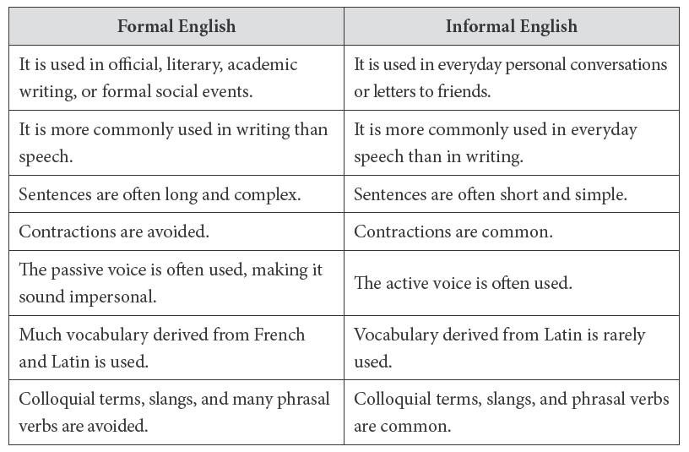
Academic language and discourse

Slide 43
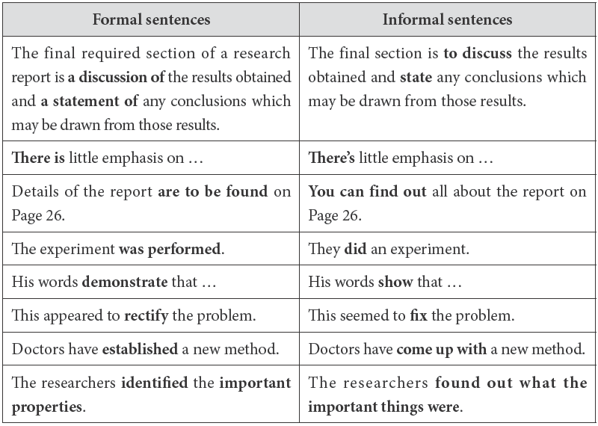
Academic language and discourse

Slide 44
Text A After reading tasks
Language building-up
Task 4 / Formal English
Replace the underlined words and expressions with more formal ones from Text A.
1 American linguist-anthropologist-hobbyist Benjamin Lee Whorf recorded this phenomenon in the 1920s.
2 In his day job as a fire-prevention engineer he noticed a large number of fires happened at gas stations.
3 Every few years the world’s leaders gather in grand meetings: Rio de Janeiro, Kyoto, Johannesburg, Copenhagen.
documented
______________
occurred
______________
conclaves
______________
Notes:
为了保证答案显示清晰，稍微调整了格式。
编者：好的，谢谢。
编辑回复：收到，谢谢吴老师！

Slide 45
Text A After reading tasks
Language building-up
Task 4 / Formal English
pronouncements
4 Solemn statements are made, but the can of global warming action is once again kicked down the road.
5 We conform to the conclusions of “scientists.”
6 The best way to fight it (but not without considerable expense) is to place a uniform tax on carbon emissions; that tax should increase until emissions fall to desirable levels.
7 The second is that we aren’t yet telling ourselves the stories that force us to combat it.
______________
defer to
______________
escalate
______________
______________
compel

Slide 46
Reading
Text B
Life Without Ice
Lead-in task
While reading
After reading tasks
Notes:
补充了Lead-in环节。
编者：好的，谢谢。之后单元也会补充该环节。
编辑回复：好的，谢谢吴老师！

Slide 47
Text B Lead-in
task
Lead-in
The ice cap of the Arctic is melting down due to climate change and global warming. Text B will touch upon the effects of the decline of sea ice and possible solutions to it.

Slide 48
Text B While reading
The focused issue
the ice cap of the Arctic
Reading task
What are the effects of the decline of sea ice and possible solutions to it?

Slide 49
Text B While reading
Supplementary Information
1. continental shelf
A continental shelf is the edge of a continent that is submerged under an area of relatively shallow water known as a shelf sea. It extends from the low-water mark, which is the lowest level reached by the sea at low tide, to a drop-off point called the shelf break. Continental shelves make up about 8 percent of the entire area covered by oceans.

Slide 50
Text B While reading
Supplementary Information
2. the Antarctic Treaty
The Antarctic Treaty was signed in Washington, D.C. on 1 December 1959 and officially entered into force in 1961. The original signatories were the twelve countries whose scientists had been active in and around Antarctica during the International Geophysical Year (IGY) of 1957-1958. The twelve countries were: Argentina, Australia, Belgium, Chile, France, Japan, New Zealand, Norway, South Africa, the Soviet Union, the United Kingdom, and the United States. Later other nations acceded to the treaty.

Slide 51
Text B While reading
Supplementary Information
3. Marine Arctic Pease Sanctuary (MAPS)
The Marine Arctic Peace Sanctuary (MAPS) is an international marine protected area, ensuring protection in perpetuity from all exploitation and militarization in all ocean space north of the Arctic Circle. It prohibits commercial and military shipping traffic, seismic survey, all extractive processes and construction of artificial islands. MAPS will be realized by a unifying international agreement, called the MAPS Treaty. It enters into force when 99 countries, including the Arctic nations, sign the Treaty.

Slide 52
Text B While reading
Supplementary Information
4. the United Nations Convention on the Law of the Sea
The United Nations Convention on the Law of the Sea (UNCLOS) is an international agreement that resulted from the third United Nations Conference on the Law of the Sea, which took place between 1973 and 1982. The Convention lays down a comprehensive regime of law and order in the world’s oceans and seas, establishing rules governing the use of oceans for fishing, shipping, exploration, navigating, mining, etc.

Slide 53
Text B While reading
Language Support
For millions of years, Arctic sea ice has expanded and retracted in a rhythmic dance with the summer sun. (Para. 1)
The prepositional phrase “in a rhythmic dance” refers to “dancing with measured regularity”（跳着有节奏的舞蹈）.
In the sentence above, the phrase could be paraphrased as “recurring with measured regularity” （交替着出现）.

Slide 54
Text B While reading
Language Support
The National Snow and Ice Data Center reported that last year’s minimum Arctic sea ice extent was the second lowest on record. Similarly, the Polar Science Center found that 2019 ended with the second lowest Arctic sea ice volume on record. (Para. 2)
If something is the best, worst, or biggest on record, it is the best, worst, or biggest thing of its kind that has been noticed and written down（有记录的；有记载的）. It is the meaning of “on record” in the text.

Slide 55
Text B While reading
Language Support
Other meanings of “on record” are provided as below:
i) If you are on record as saying something, you have said it publicly and officially and it has been written down.
e.g. The Chancellor is on record as saying that the increase in unemployment is ‘a price worth paying’ to keep inflation down.
ii) If you keep information on record, you write it down or store it in a computer so that it can be used later.
e.g. The practice is to keep on record any analysis of samples.

Slide 56
Text B While reading
Language Support
Once dark water replaces brilliant ice, Earth could warm substantially, equivalent to the warming triggered by the additional release of a trillion tons of carbon dioxide into the atmosphere. (Para. 3)
In the text, the phrase “equivalent to” refers “being equal to in value, measure, force, effect, significance, etc.”（等于；相当于）. Another meaning is “being corresponding or virtually identical especially in effect or function”.
e.g. In some ways their prime minister is equivalent to our president.

Slide 57
Text B While reading
Language Support
A new Marine Arctic Peace Sanctuary (MAPS) Treaty—a proposed addendum to the United Nations Convention on the Law of the Sea—would protect the Arctic Ocean as a scientific preserve for peaceful purposes only. (Para. 6)
Scientists can help—just as they did for the Antarctic—by giving statements of support (at signmaps. org), asking scientific organizations to endorse the treaty, ... (Para. 6)

Slide 58
Text B While reading
Language Support
Parenthetical statements, as one of the particular type of signpost language, allow a writer to insert additional information without creating a separate sentence and are often demonstrated by parentheses and dashes. For example:
Researchers examined how much the wages of the respondents depended on the standard determinants—education, experience, and so on—and how they depended on physical appearance.
He considered an example with two goods (wine and cloth) and two countries (the UK and Portugal).

Slide 59
Text B While reading
Critical reading and thinking
Task 1 / Overview
Complete the following table about the main points of the text.
Thesis statement ____________________________________________________________________________
Effects | Although most people have never seen the sea ice, its effects are never far away. 1. Once dark water replaces brilliant ice, ____________________________; 2. ____________________________________; 3. ____________________________________; 4. The sea ice conceals not just algae, but also _______________________________________________________________________________________.
As the northern sea ice declines, the world must unite to preserve what remains of the Arctic.
the Earth could warm substantially
The ice also determines who gets rain
Declining sea ice threatens wildlife
90 billion barrels of oil and 1.7 trillion cubic feet of natural gas that neighboring countries would like to claim

Slide 60
Text B While reading
Critical reading and thinking
Task 1 / Overview
advocate not just for lowering
Solutions | The scientific community should ________________________ ________________________________________________________________. A new Marine Arctic Peace Sanctuary (MAPS) Treaty: a proposed addendum to the United Nations Convention on the Law of the Sea would ________________________________ __________________________________________________________________________________________________________________________________.
greenhouse gas emissions, but also for protecting the Arctic from exploitation
protect the Arctic Ocean as a scientific
preserve for peaceful purposes only. It would prohibit resource extraction, commercial fishing and shipping, seismic testing, and military exercises

Slide 61
Text B After reading tasks
Researching
Task
With its unprecedented economic growth, China has taken active steps toward protecting the environment. China is now making great efforts to strengthen pollution prevention and control, restore and protect ecosystems, and promote the environmental protection industry. Work in groups of 4-5 and brainstorm the cases of environmental protection in some regions of China. Then choose one case to conduct a survey.

Slide 62
Text B After reading tasks
Researching
The following prompts may be helpful to you.
1 What was the environmental status of the region in former years?
2 What measures has the local government taken to solve the environmental problems in the region?
3 What achievements has the local government made?
4 What are your reflections on the case?
Present the findings of your survey to the class.

Slide 63
Text B After reading tasks
Researching
Reference answers
Example: Inner Mongolia lake once foul, but now flourishing
1. The environmental status of the region in the former years
A black, odorous body of water used to be dotted with dead fish in the Inner Mongolia autonomous region. According to local authorities, the lake’s environment deteriorated due to years of pollution from agricultural, industrial and domestic waste water, with inadequate replenishment of the lake water from the Yellow River making the situation even grimmer.

Slide 64
Text B After reading tasks
Researching
Reference answers
2. Measures that the local government has taken to solve the environmental problems in the region
The water has become beautiful. According to local authorities, aside from beefing up fertilizer and pesticide control at nearby farms, 11 sewage treatment plants have been built in the area as part of the local government’s efforts to prevent pollutants from entering the lake. A 60-square-kilometer wetland has also been created to help purify water before it enters Ulansuhai Nur. The local government has also been diverting water from the Yellow River during the flood season to supplement the water body.

Slide 65
Text B After reading tasks
Researching
Reference answers
3. Achievements that the local government has made
There has been a sharp decrease in the number of mosquitoes. In stark contrast, the number of birds has risen noticeably. According to local authorities, over 260 bird species either live at the lake or rest there as they migrate. Their number totals 6 million. Some of the parameters for water quality assessment in some parts of the lake have reached as high as Grade II, the second-highest level.

Slide 66
Text B After reading tasks
Language building-up
Task 1 / Academic vocabulary
Complete the following sentences with the words from the box. Change the form where necessary.
stability | advocate | expand | evolve | minimum
demonstrate | equivalent | trigger | convince | ultimately
1 The residential and institutional center is built with ______________ impact to the environment while embracing the highest technological standards.
2 Through the reduction of our consumption behavior and by ______________ others to change their daily consumption behavior, everyone can make a huge impact to mitigate (使缓和) the global warming issue.
minimum
convincing

Slide 67
Text B After reading tasks
Language building-up
Task 1 / Academic vocabulary
3 Earthquakes are a major landslide trigger, and evaluation of the dynamic ______________ of landslides under seismic action is very important.
4 For the United States and Europe, air pollution is ______________ in detrimental health effects to smoking 0.4 to 1.6 cigarettes per day.
5 They should strongly ______________ for conservation of resources and promote environment-friendly manufacturing.
6 A remotely ______________ rockburst is a typical engineering geology disaster that occurs during the excavation of hard rock at depth.
stability
equivalent
advocate
triggered

Slide 68
Text B After reading tasks
Language building-up
Task 1 / Academic vocabulary
7 Assisting these countries in working toward sustainable socioeconomic development and enhancement of marine environment protection will ______________ result in cleaner coasts and increased tourism.
8 This research ______________ scientific understanding of the impact of environmental factors on fertility outcomes.
9 Researchers ______________ the effectiveness of an environmental warning system to monitor the coast.
10 The new study examined four independent, geographically-separated populations of fish, each of which has ______________ resistance to industrial chemicals.
ultimately
expands
demonstrate
evolved

Slide 69
Text B After reading tasks
Language building-up
Task 2 / Collocations
Complete the following sentences by translating the Chinese in brackets into English, using the given words in proper forms and collocations.
1 It wouldn’t be wise to ___________________ (完全依赖; rely) technology to save our planet. We will also need to change our lifestyles in order to start rolling back the damage we’ve done.
2 May 2020 was the warmest May ___________________ (记录在案的; record), according to one internationally recognized dataset.
3 G7 (Group of Seven) environment talks ___________________ (以……结束; end) a wide gap between the US and the other six countries on climate.
rely entirely on
on record
end with

Slide 70
Text B After reading tasks
Language building-up
Task 2 / Collocations
4 The material, while provided with intrinsic properties ___________________ (相当于; equivalent) those of conventional materials, does not contain toxic heavy metals and thus imposes little impact on the environment at the time of landfill and incineration.
5 The study finds that the Central Plains could become drier, even though it may not receive less rain in the future, simply because warmer temperatures will drive evaporation to ___________________ (使干透; dry) the rich soils.
equivalent to
dry out

Slide 71
Text B After reading tasks
Language building-up
Task 2 / Collocations
6 ___________________ (大量的; abundance) clean water enables food production and protects the environment.
7 The water-rich country promises to maintain at least 60% of the landmass under forest ___________________ (永久地; perpetuity) at any given point of time.
8 The retailers ___________________ (签约; sign) to raise awareness of climate change.
An abundance of
in perpetuity
sign on

Slide 72
Viewing
Prediction
Notes:
编者：为了与Reading - Text A和Text B里面的主题页一致，在Viewing板块添加了一张主题页。
编辑回复：好的，谢谢吴老师！之后的单元也可进行统一调整。

Slide 73

Viewing
Prediction
Task 1
You will watch a video clip about what people can do to reduce carbon emissions. Before watching, write down what you expect to hear.
Notes:
已补充视频链接。
编者：好的，谢谢。
编辑回复：收到，谢谢吴老师！

Slide 74
Viewing
Prediction
Task 2
Watch the video clip and complete the following table that shows what people can do to stop global temperatures rising in the UK.
What can be done? | How much CO2 would be saved if all did it?
1) ___________________________________ | 128 thousand tonnes
2) ___________________________________ | _________________
3) ___________________________________ | 3.2 million tonnes
4) ___________________________________ _______________ | _________________
5) ___________________________________ | _________________
6) ___________________________________ | 79 million tonnes
planting trees
recycling
2.4 million tonnes
using energy-saving light bulbs
cutting the energy used in the treatment of wasted water
7.9 million tonnes
giving up your car
70 million tonnes
ending veggie

Slide 75
Speaking
Analyzing your audience
Notes:
编者：为了与Reading - Text A和Text B里面的主题页一致，在Speaking板块添加了一张主题页。
编辑回复：好的，谢谢吴老师！后续单元也可进行统一调整。

Slide 76
Speaking
Analyzing your audience
When preparing for your presentation, analyse your audience in terms of:
background information
wants and needs
level of English proficiency
knowledge of the subject
Keep the audience in mind throughout the preparation of your presentation.

Slide 77
Writing
Guidelines
Macro structure
Micro skills
Tasks after class
Notes:
编者：在Writing首页之后的每个页面左上角均显示Writing以及所对应的内部板块名称。
编辑回复：好的，谢谢吴老师！后续单元也可进行统一调整。

Slide 78
Writing
Guidelines
Guidelines
 | Macro structures | Micro skills
1 | Choosing a topic | Searching for information
2 | Shaping an essay & Writing an outline | Writing a good research question
3 | Writing an introduction | Thesis statement
4 | Body – Argumentation (1) | Definition
5 | Body – Argumentation (2) | Supporting evidence & Logical reasoning
6 | Body – Exposition (1) | Quotation and paraphrase & Marking the cited sources
7 | Body – Exposition (2) | Hedging
8 | Conclusion | Summarizing
9 | References | Coherence
10 | Proofreading | Proofreading

Slide 79
Writing
Macro
Structure
Macro Structure
Choose a topic
Choose a topic that really intrigues you.
Narrow down a topic.
Avoid a topic that has very limited relevant source materials.
Deepen your thinking in the researching process and strengthen your ideas.

Slide 80
Writing
Micro
Skills
Micro Skills
Searching for information
Library
the Internet

Slide 81
Writing
Tasks after
class
Academic essay
Task 1
Which of the following topics are suitable and manageable for a 1,000-word essay? Tick (√) your choices and give your reasons.
Climate change
Importance of studying mathematics
Gender relations in Jane Eyre
Robert Frost’s attitude toward death
Chinese university students’ attitudes toward DINK family
Effects of globalization on people’s life
A survey of some resident physicians’ life
√
√
√
√
√

Slide 82
Writing
Tasks after
class
Academic essay
Task 2
Write down the topics that you are curious about. Make sure they are specific and feasible.

